Slide 1
Impact of Interest Rates on Recessions, Inflation, Unemployment and the Global Economy.
Armann Andaya, Justin Dean, Michelle Owino, Riley Unverferth, Kenan White

Slide 2
Questions:
Do interest rate hikes cause recessions?
Based on the current trajectory, is another recession coming? If so, when?
What effect does increase/decrease of interest rates have on unemployment rate?
Does the federal interest rate impact inflation?
Does an increase in interest rates in the United States affect the global economy?

Slide 3
Context
Background and why we picked topic

Slide 4
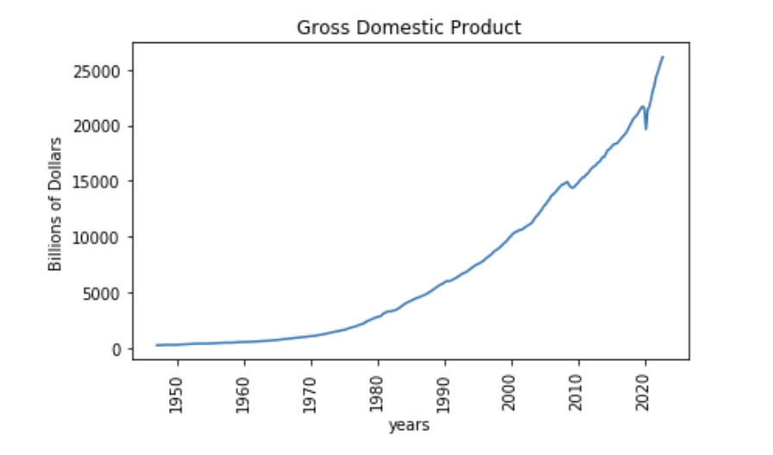
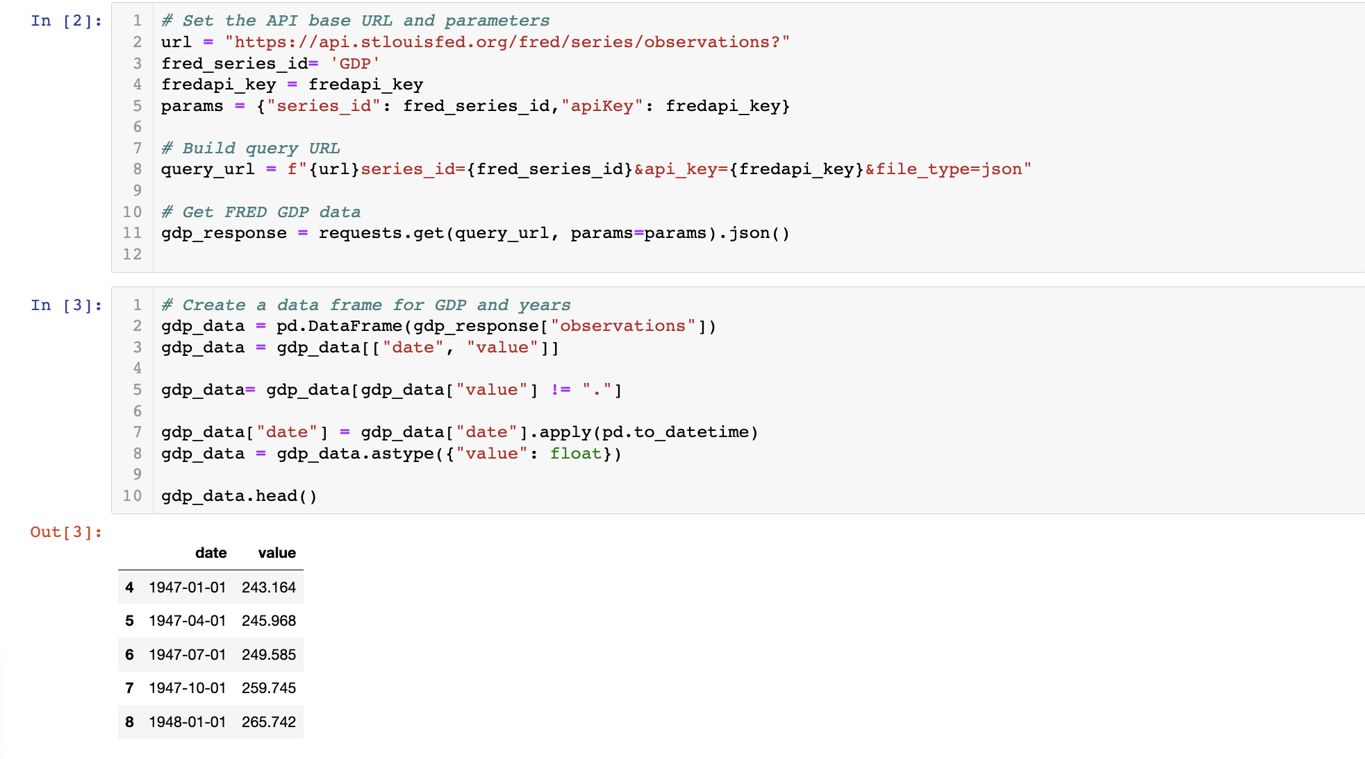

Slide 5
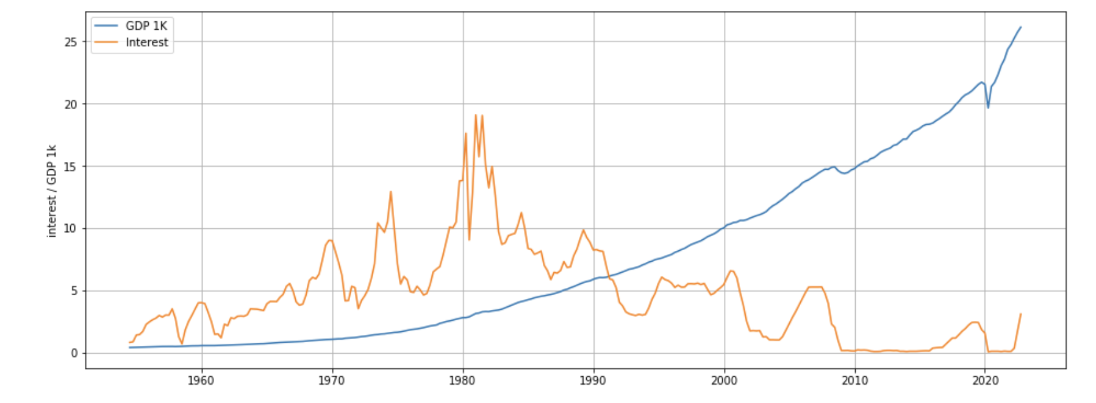

Slide 6
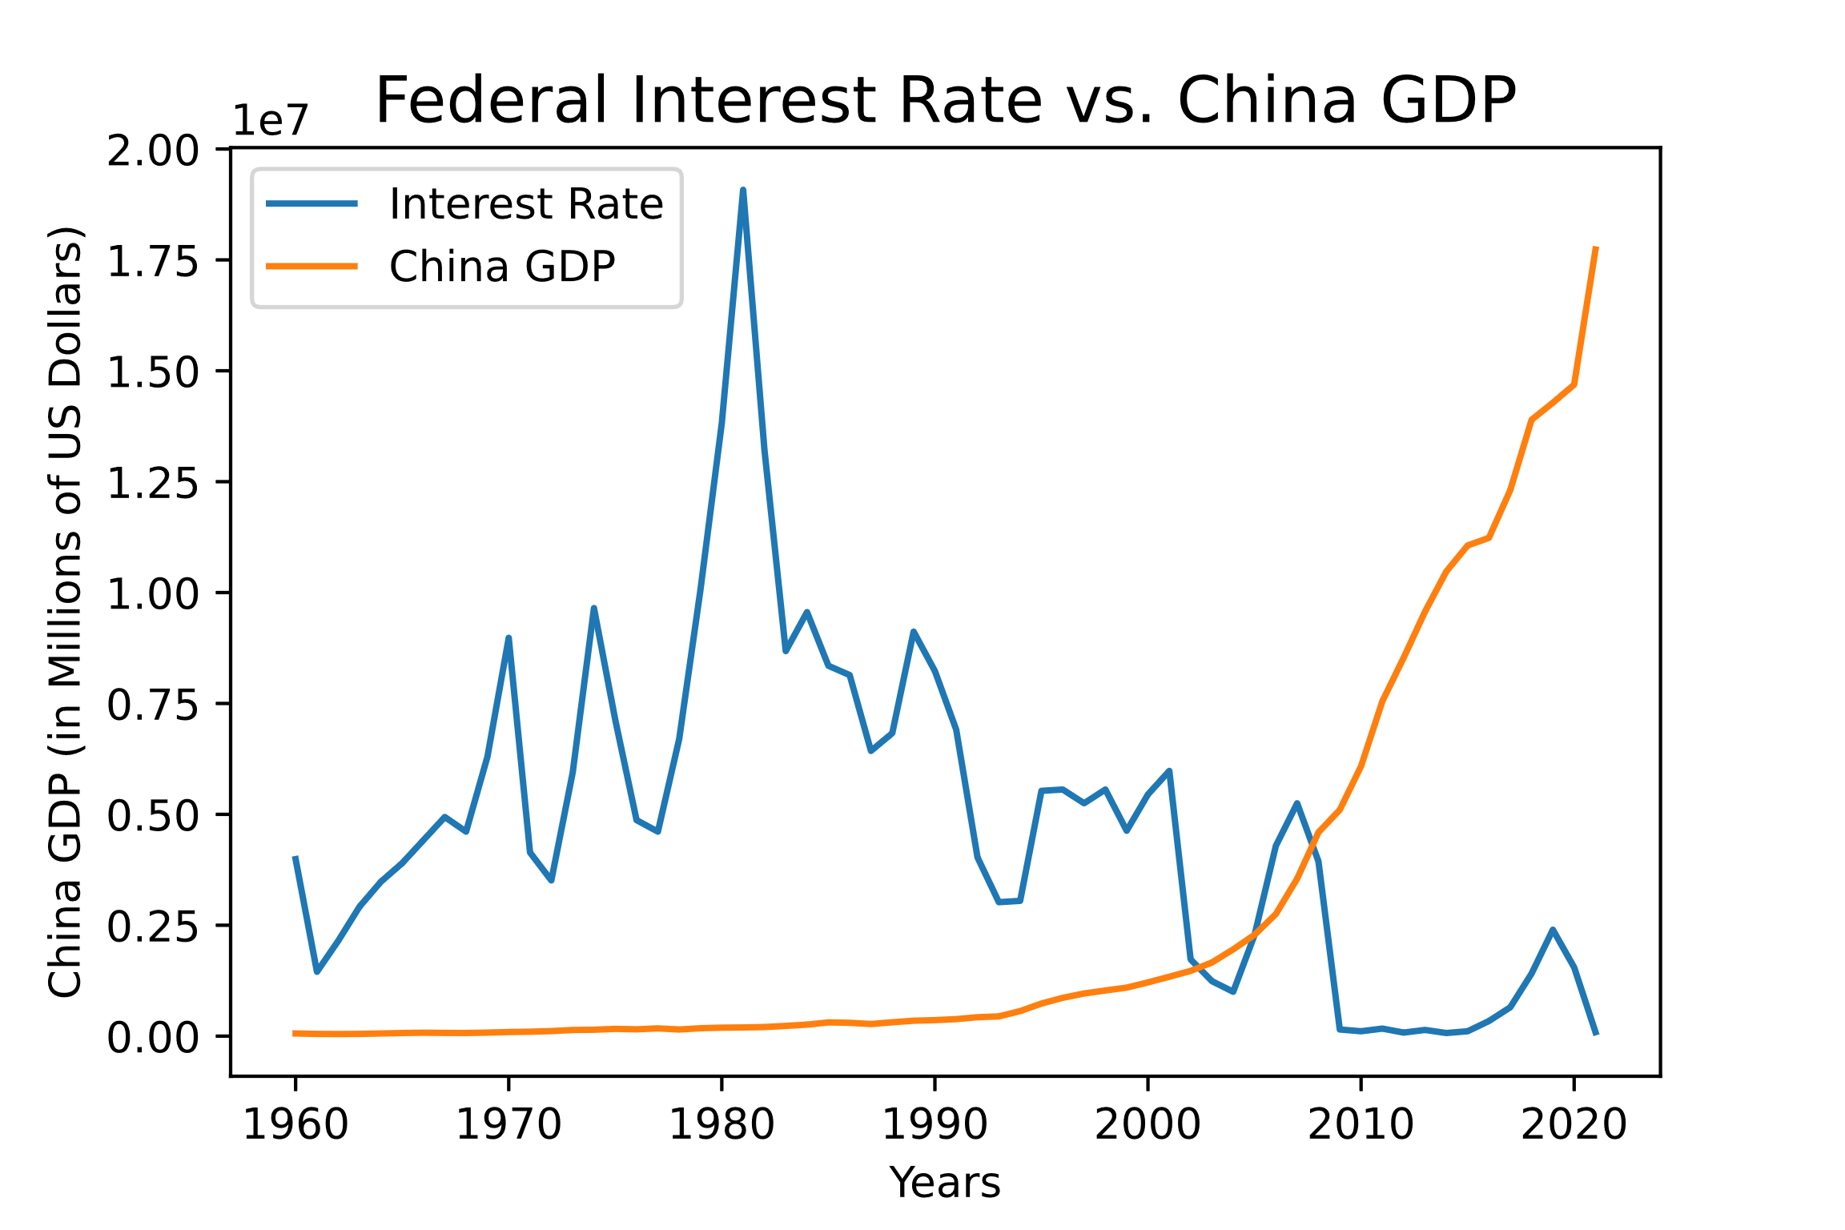
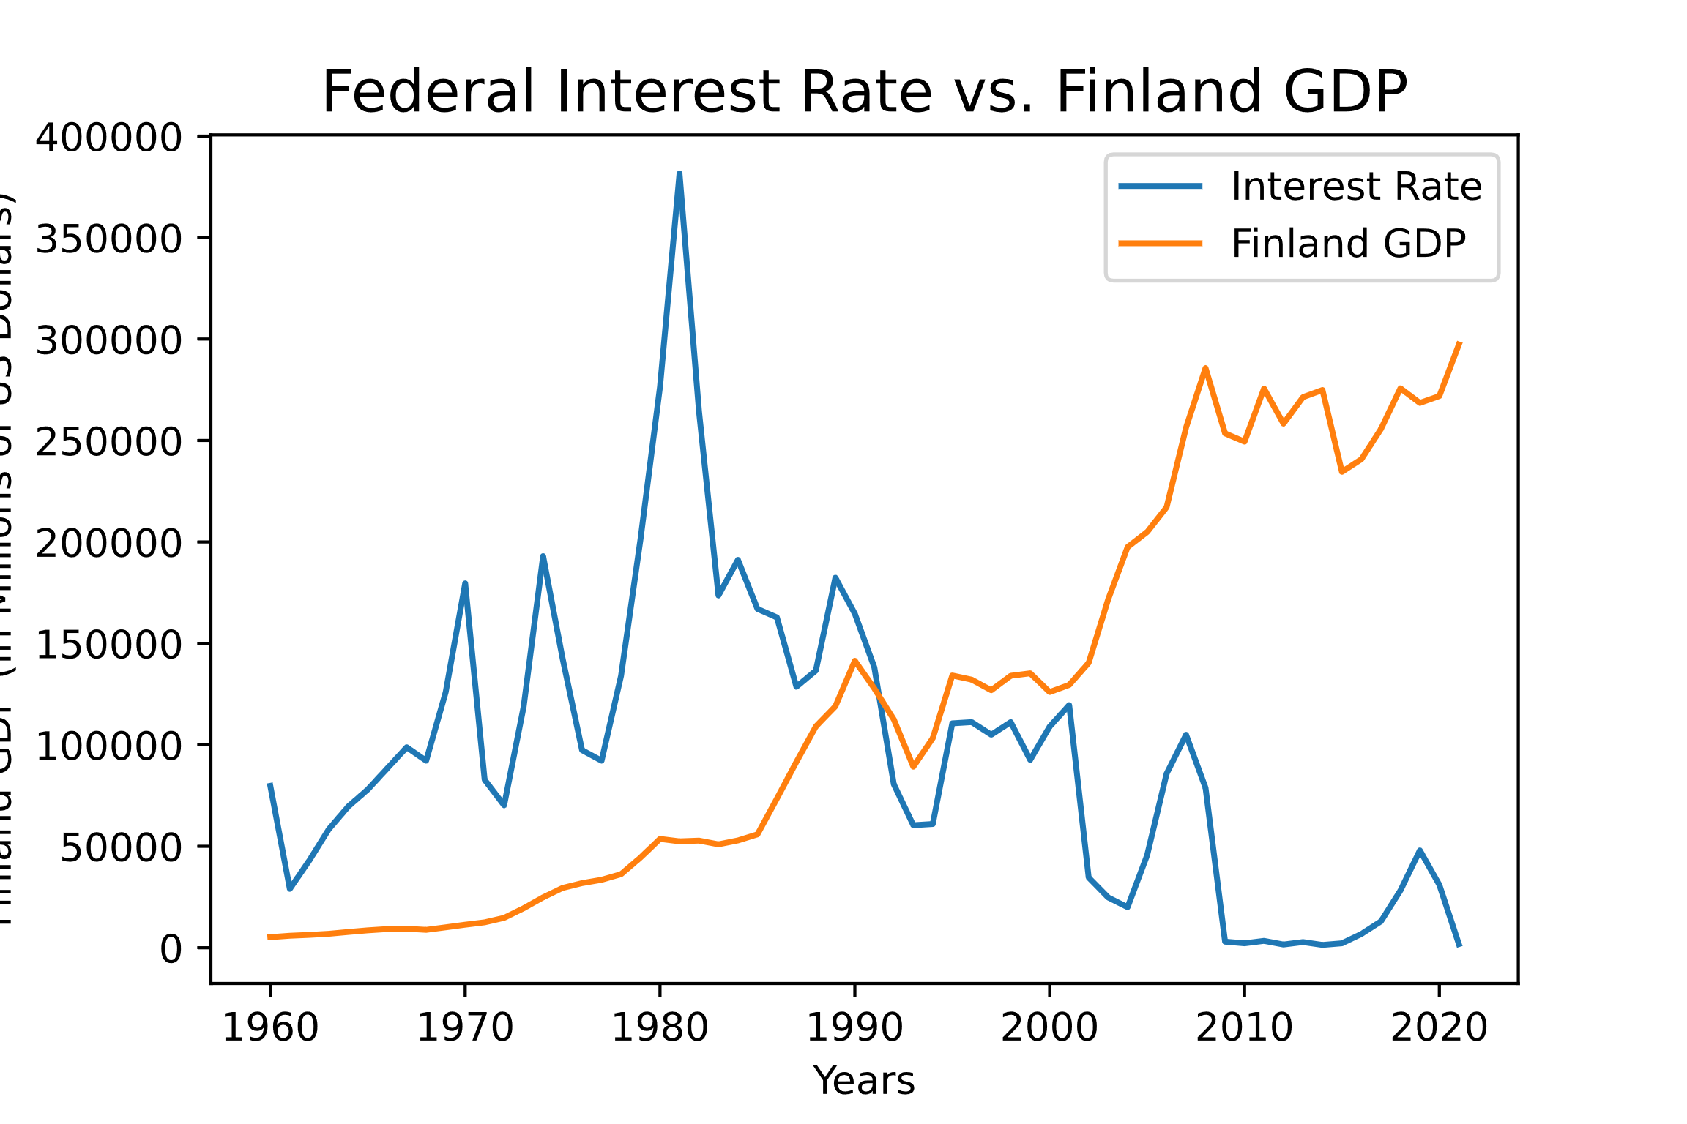
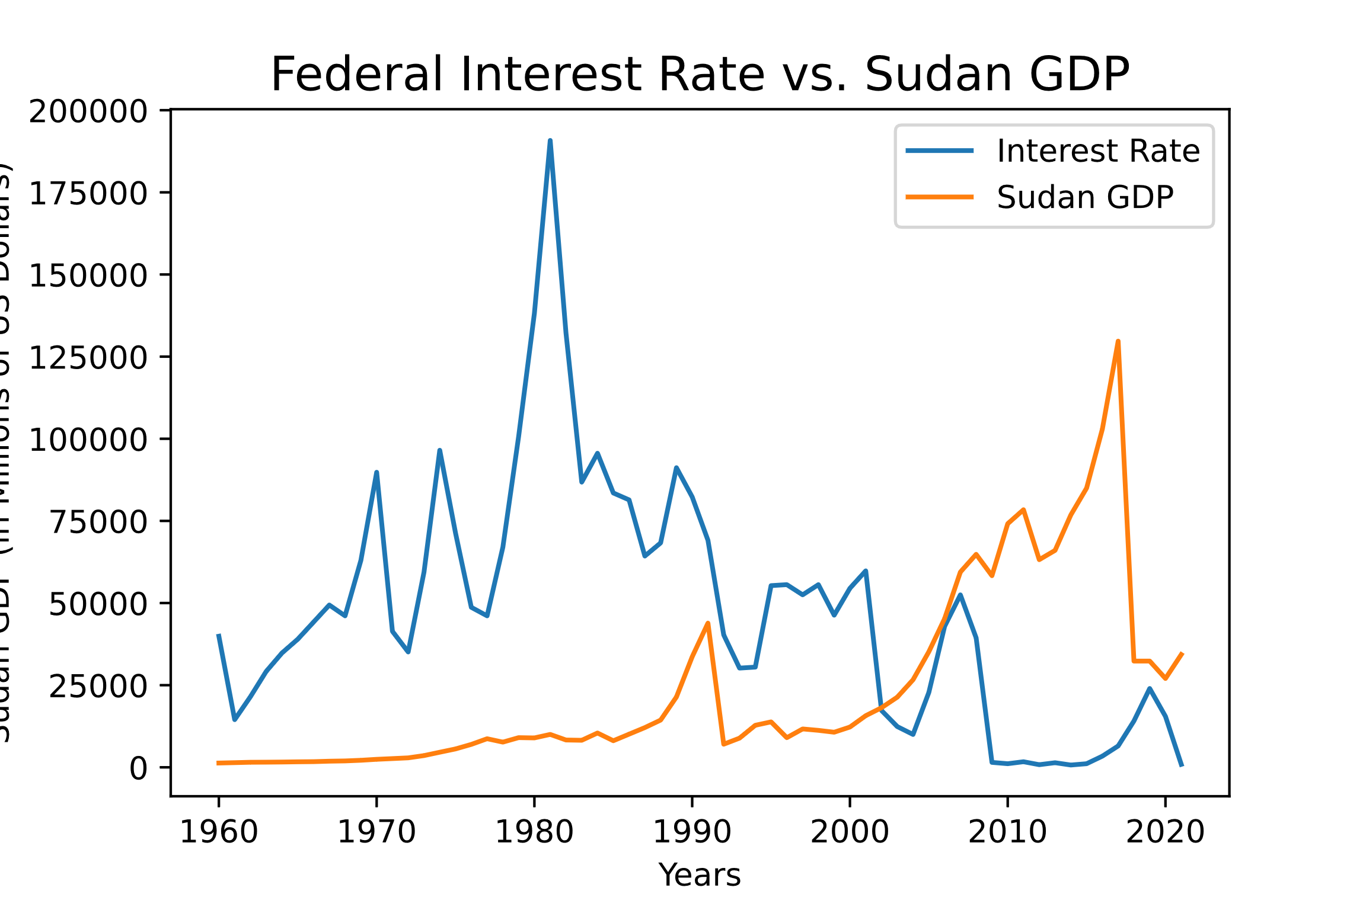
Global impact of federal interest rate
Economy Similar in Size as US
Bottom of the ‘Top 50 Economies’
Economy of Third World Country

Slide 7
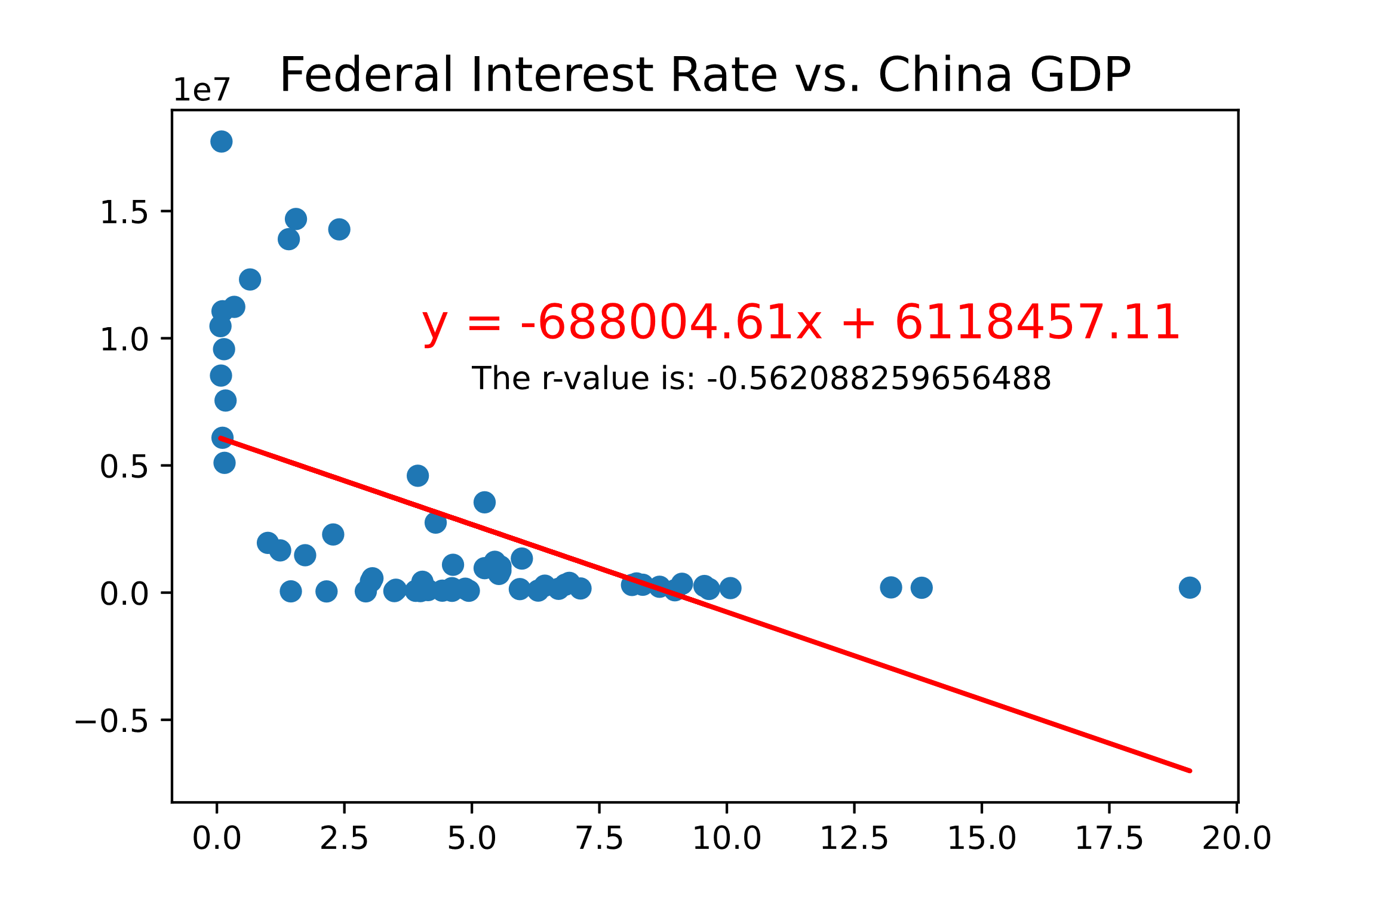
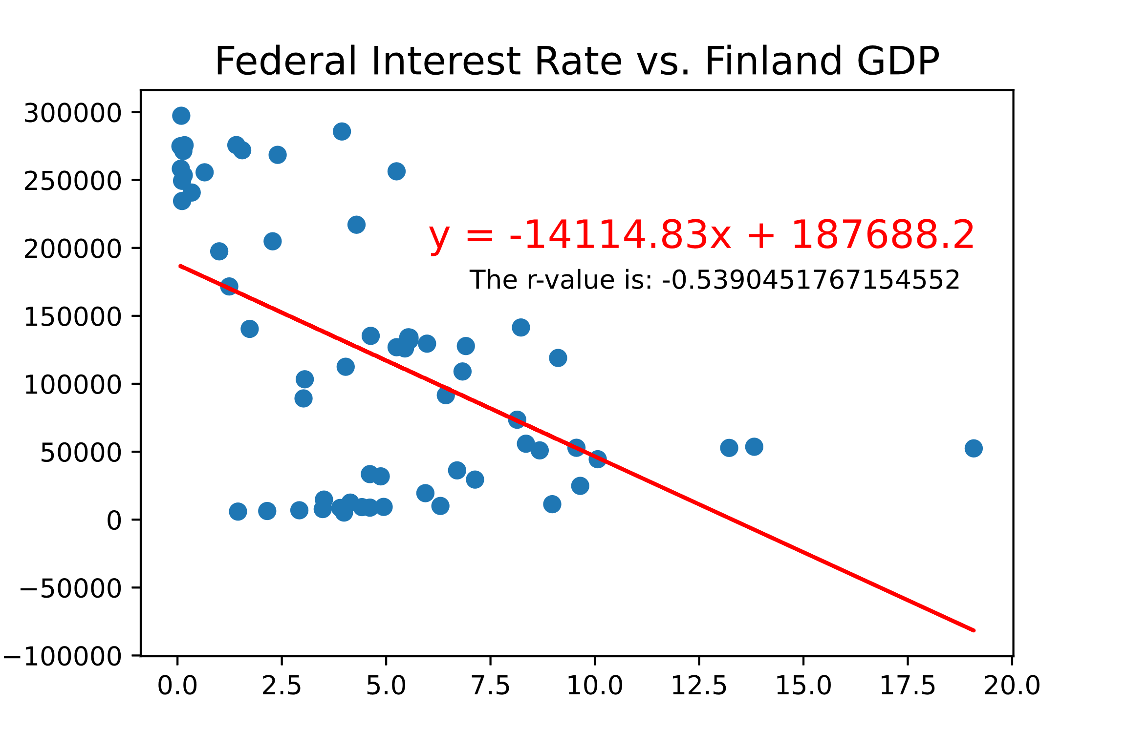
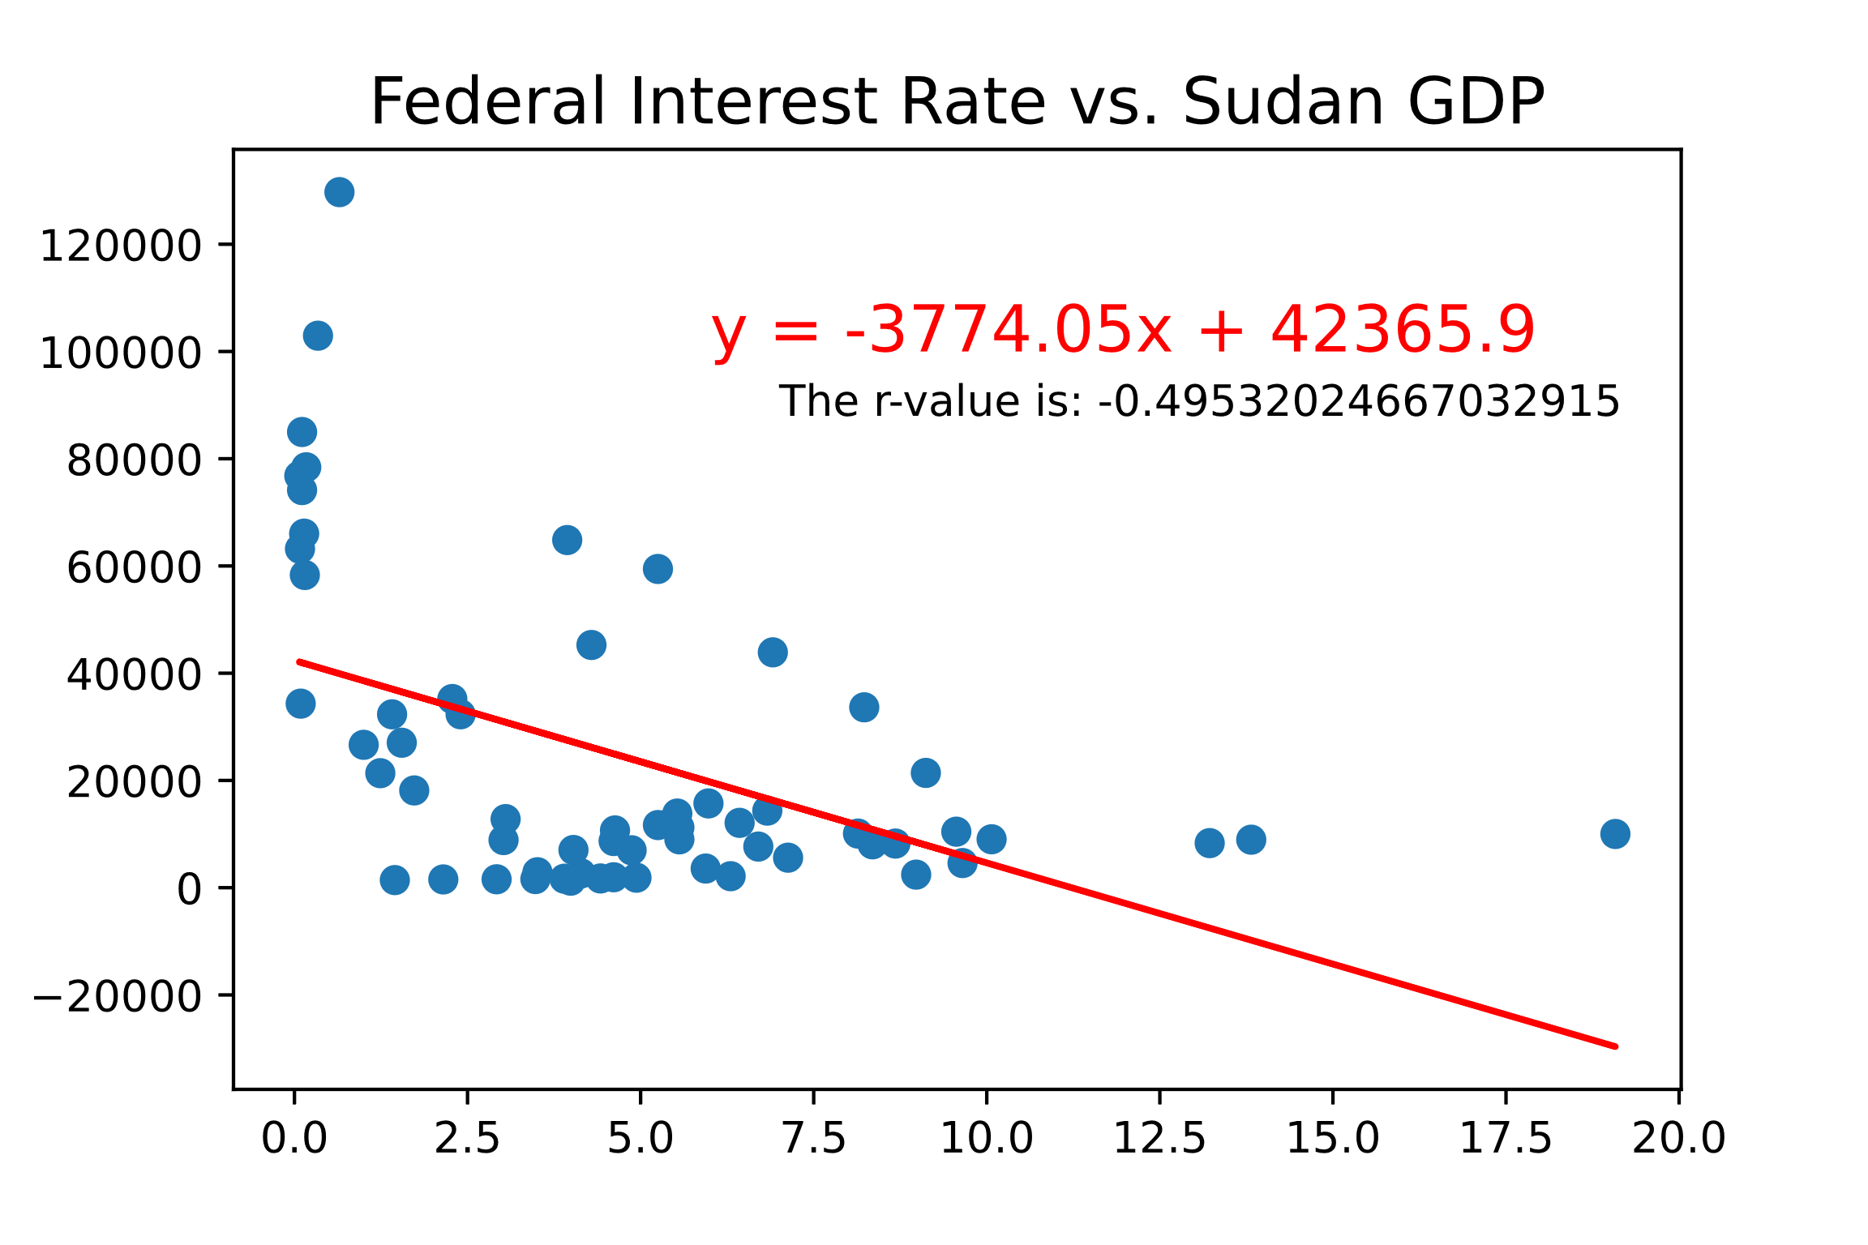
Global impact of federal interest rate
Moderate Negative Correlation
Moderate Negative Correlation
Weak Negative Correlation

Slide 8
Conclusion
5 conclusions based on questions

Slide 9

THANK YOU
Armann Andaya
Justin Dean
Michelle Owino
Riley Unverferth
Kenan White

